Slide 1
Active Shooter Situation: How to Respond
For Averett University Faculty & Staff
Spring 2023

Slide 2
Objectives
Share the structure of the Averett University Emergency Response Team (ERT);
Describe emergency protocols and key actions to keep your classroom or office safe upon notification;
Explain “Run. Hide. Fight.”
Describe appropriate actions when confronted by law enforcement officers.
Outline next steps.

Slide 3
Averett University Emergency Response Team
Incident Commander
Don Aungst/Venita Mitchell
Public Information Officer
Cassie Jones
Operations Section
Bruce Devlin/JL Porter
Logistics Section
Meg Stevens/Bren Taylor
Finance/Administration Section
Sandy Isom/Tammy Wall
Campus Support
(Housing & Residence Life, Dining Services, Student Engagement, Counseling, and Spiritual Life)
Various
Liaison Officer
Billy Wooten/Tia Yancey
Safety Officer
Campus Safey and Security
Kristal Emerson/Officer on Duty
Campus Facilities
Kevin Farthing/Jeff Warren
Planning Section
Ginger Henderson/Lee Beaumont
Academic Affairs
Ginger Henderson/Jackie Finney
Enrollment Management
Roger Ott/Matt Mann
IT
Michael Boehm
Finance
(Time & Cost Tracking and Procurement)
Sandy Isom/Tammy Wall
Event Management
Lynsey Corriher
Student Life
JL Porter/Rodney Countryman

Slide 4
Active Shooter Incident
An Active Shooter is an individual actively engaged in killing or attempting to kill people in a confined and populated area; in most cases, active shooters use firearms(s) and there is no pattern or method to their selection of victims.
Active shooter situations are unpredictable and evolve quickly. Typically, the immediate deployment of law enforcement is required to stop the shooting and mitigate harm to victims.
Because active shooter situations are often over within 10 to 15 minutes, before law enforcement arrives on the scene, individuals must be prepared both mentally and physically to deal with an active shooter situation.
Taken from Homeland Security’s Active Shooter Response Paper

Slide 5
Be Prepared
Be aware of surroundings.
Know exact location/address.
Have an escape plan.
Talk with students and co-workers.
Cover windows.
Practice shelter-in-place conditions.

Slide 6
How to Report Emergencies
911
Safety and Security: 1-5888 (on campus) and
434-791-5888 (from cell or off campus)
Campus Blue Light Phones
LiveSafe

Slide 7
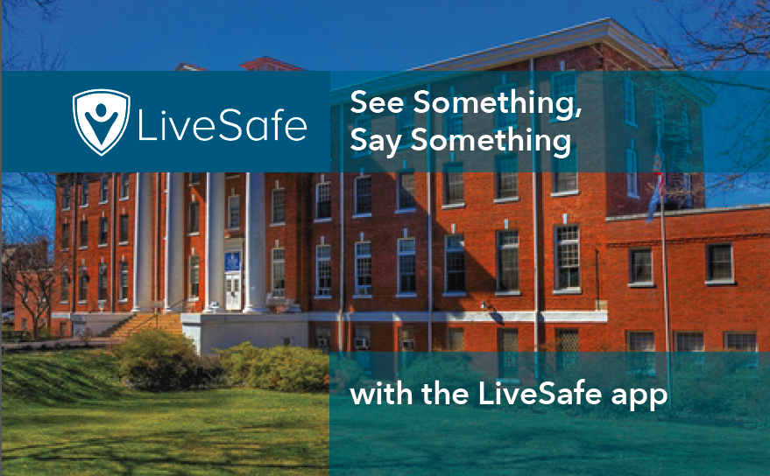

Slide 10
Lockdown
Immediately lock/secure all doors.
Close windows and blinds.
Shut off lights.
Silence your cell phone.
Hide out of sight and stay in your location.
Do not allow anyone into room except emergency responders or safety and security.
Monitor notifications.

Slide 11
Role of Faculty and Staff
Lead by example.
Remain calm.
Take emergency protective actions.
Follow official public safety instructions.

Slide 12
Facing an Active Shooter
RUN.
HIDE.
FIGHT.
Prioritize LIFE SAFETY.
Call Averett Safety and Security when safe 1-5888.

Slide 13
Run. Hide. Fight
RUN if a safe exit route is visible.
Move quickly and cautiously.
Don’t hesitate. Seconds matter.
Remember doors and windows.
Leave belongings behind.

Slide 14
Run. Hide. Fight
HIDE if unable to evacuate.
Lock or blockade doors and windows, turn off lights, close blinds.
Silence your cell phone, etc.
Hide behind solid objects.
Remain very quiet.

Slide 15
Run. Hide. Fight
FIGHT as a last resort, and only if your life is in immediate danger.
Attempt to incapacitate the shooter.
Act with physical aggression.
Improvise weapons.
Commit to your actions.

Slide 16
Law Enforcement Response
Police will not assist injured until threat is contained.
If told to exit building, keep hands up/visible.
Remain calm.
Avoid pointing or yelling.

Slide 17
Ending the Lockdown
LifeSave notifications: text, email and app notifications
Website
Social media posts
Message: “Active Shooter Incident is over….”

Slide 18
Next Steps
Table top exercises for ERT, then for full faculty, staff and students.
Active Shooter Drill on campus.
Safety and Security workshops on different topics.

Slide 19
Questions? Contact Averett’s Emergency Response Team Members Don Aungst, VP, CFO/COO Dr. Venita Mitchell, VP of Student Engagement Bruce Devlin, Chief of Campus Safety & Security, Director of Facilities Cassie Jones, AVP of University Marketing & Communications

